Slide 1
ALU Design using Verilog
Lab 3
By: Er. Shiva Raj Luitel

Slide 2
Objective
To implement ALU using Verilog HDL.

Slide 3
ALU
An arithmetic logic unit (ALU) is a digital circuit used to perform arithmetic and logical operations. It represents the fundamental component of a computer's CPU. Modern processors contain very powerful and complex ALUs. In addition to ALUs, modern CPUs contain a control unit (CU).
An ALU performs basic arithmetic and logic operations. Examples of arithmetic operations are addition, subtraction, multiplication, and division. Examples of logical operations are comparisons of values such as NOT, AND, and OR

Slide 4
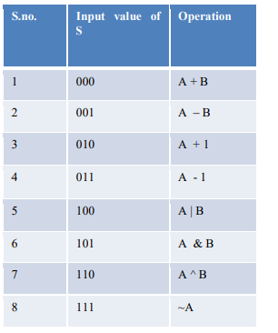
ALU Operation Table

Slide 5
Verilog code
always @ ( a,b,s )
begin
if ( s == 3'b000)
begin
temp = {0,a} + {0,b};
yout = temp [3:0];
cf = temp [4];
end
else if ( s == 3'b001)
begin
temp = {0,a} - {0,b};
yout = temp [3:0];
cf = temp [4];
end
else if ( s == 3'b010)
begin
temp = {0,a} + 5'b00001;
yout = temp [3:0];
cf = temp [4];
end
else if ( s == 3'b011)
begin
temp = {0,a} - 5'b00001;
yout = temp [3:0];
cf = temp [4];
end
else if ( s == 3'b100)
begin
temp = a | b;
yout = temp [3:0];
cf = temp [4];
end
else if ( s == 3'b101)
begin
temp = a & b;
yout = temp [3:0];
cf = temp [4];
end
else if ( s == 3'b110)
begin
temp = a ^ b;
yout = temp [3:0];
cf = temp [4];
end
else if (s == 3'b111)
begin
temp = ~a;
yout = temp [3:0];
cf = temp [4];
end
end
endmodule
module ALU (a, b, s, yout, cf);
input [3:0] a;
wire [3:0] a;
input [3:0] b;
wire [3:0] b;
input [2:0] s;
wire [2:0] s;
output [3:0] yout;
reg [3:0] yout;
output cf;
reg cf;
reg [4:0] temp;

Slide 6
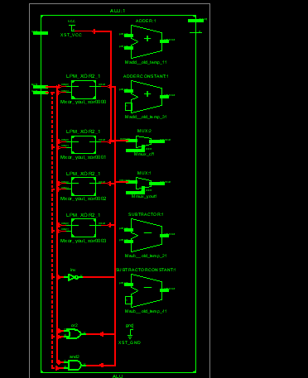
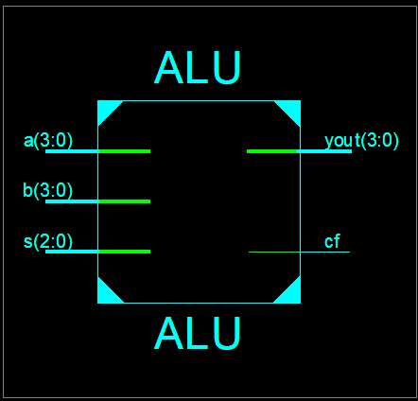
RTL and technology schemetic

Slide 7
Test Fixture
initial begin
a = 0;
b = 0;
s = 0;
#100;
a=5;
b=6;
s=1;
#100;
a=5;
b=6;
s=2;
#100;
a=5;
b=6;
s=3;
#100;
a=5;
b=6;
s=4;
#100;
end
endmodule

Slide 8
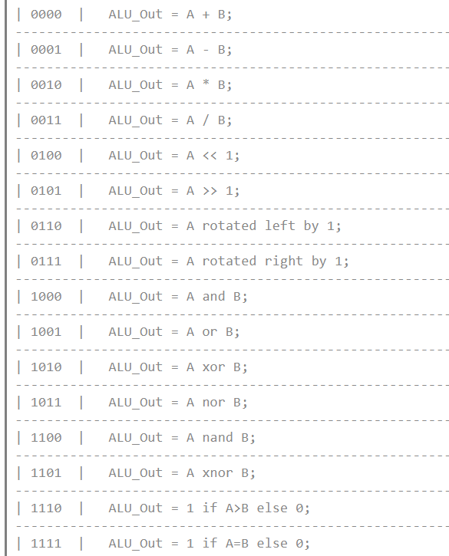

Slide 9
Verilog Coding
module alu(
input [7:0] A,B, // ALU 8-bit Inputs
input [3:0] ALU_Sel,// ALU Selection
output [7:0] ALU_Out, // ALU 8-bit Output
output CarryOut // Carry Out Flag
);
reg [7:0] ALU_Result;
wire [8:0] tmp;
assign ALU_Out = ALU_Result; // ALU out
assign tmp = {1'b0,A} + {1'b0,B};
assign CarryOut = tmp[8]; // Carryout flag

Slide 10
Contd…
always @(*)
begin
case(ALU_Sel)
4'b0000: // Addition
ALU_Result = A + B ;
4'b0001: // Subtraction
ALU_Result = A - B ;
4'b0010: // Multiplication
ALU_Result = A * B;
4'b0100: // Logical shift left
ALU_Result = A<<1;
4'b0101: // Logical shift right
ALU_Result = A>>1;
4'b0110: // Rotate left
ALU_Result = {A[6:0],A[7]};
4'b0111: // Rotate right
ALU_Result = {A[0],A[7:1]};
4'b1000: // Logical and
ALU_Result = A & B;
4'b1001: // Logical or
ALU_Result = A | B;
4'b1010: // Logical xor
ALU_Result = A ^ B;
4'b1011: // Logical nor
ALU_Result = ~(A | B);
4'b1100: // Logical nand
ALU_Result = ~(A & B);
4'b1101: // Logical xnor
ALU_Result = ~(A ^ B);
4'b1110: // Greatercomparison
ALU_Result = (A>B)?8'd1:8'd0 ;
4'b1111: // Equal comparison
ALU_Result =(A==B)?8'd1:8'd0 ;
default: ALU_Result = A + B ;
endcase
end
endmodule

Slide 11
Test fixture
initial begin
A = 8'h0A;
B = 8'h02;
ALU_Sel = 4'h0;
for (i=0;i<=15;i=i+1)
begin
ALU_Sel = ALU_Sel + 4'h01;
#10;
end;
A = 8'hF6;
B = 8'h0A;
end

Slide 12
Observation
RTL and Timing diagram

Slide 13
Discussion and conclusion

